Slide 1
RV College of Engineering
Go, change the world
Course Name: Principles of Programming using C
Course Code: 22CS23
Unit I
Department of AIML RVCE

Slide 2


RV College of Engineering
Unit 1- Logical Reasoning and Algorithmic Problem Solving
Go, change the world
Skill development – Examples related to Arithmetical Reasoning and Analytical Reasoning
ARITHMETIC REASONING
➢Arithmetic reasoning helps us to select the required information from a given question and solve that question using some mathematical concepts.
➢Arithmetic operations are carried out when there is a requirement of solving with mathematical operations such as addition, subtraction, multiplication and division.
➢It primarily deals with converting the word problem and transforming it into equations in order to reach a solution.

Slide 3
RV College of Engineering
Unit 1- Logical Reasoning and Algorithmic Problem Solving
Go, change the world
Skill development – Examples related to Arithmetical Reasoning and Analytical Reasoning
Arithmetic reasoning questions are asked from a number of areas:
Algebra
Ages
Ratio & proportion
Sequences & patterns
Percentages
HCF & LCM, Fractions
Games & Tournaments

Slide 4
RV College of Engineering
Unit 1- Logical Reasoning and Algorithmic Problem Solving
Go, change the world
Skill development – Examples related to Arithmetical Reasoning and Analytical Reasoning
Example 1:
Nikhil is 2 times as old as Abhay. In the next 3 years, the sum of their respective ages will be 66. How old are they presently?
Let the age of Abhay = x. As, Nikhil is twice as old as Abhay, his age can be represented as 2x.
After 3 years, Abhay’s age will be x + 3, and Nikhil’s age will be 2x + 3. The sum of their ages will be 66.
So, the equation becomes:
x + 3 + 2x + 3 = 66
x = 20, so their respective ages will be : 20 years and 40 years.
So, we can solve the equation using one or two variables as per the question requires.

Slide 5
RV College of Engineering
Unit 1- Logical Reasoning and Algorithmic Problem Solving
Go, change the world
Skill development – Examples related to Arithmetical Reasoning and Analytical Reasoning
Example 2:
Joseph is now 1/4th times as old as his mother Ketty. Four years hence, his mother will be three times as old as her son. The age of his mother Ketty (in years) is
Let Joseph’s mother Ketty age be 4x years. Then, Joseph’s age = x years.
Four years hence, Joseph's age = (x + 4) years and Joseph’s mother Ketty age = (4x + 4) years. So, 4x+4= 3 (x+4)
4x-3x= 12-4;
x = 8.
Joseph's mother Ketty age = 4x= 4 x 8=32 years

Slide 6
RV College of Engineering
Unit 1- Logical Reasoning and Algorithmic Problem Solving
Go, change the world
Skill development – Examples related to Arithmetical Reasoning and Analytical Reasoning
Example 3:
Rina & Rohit are playing a game, Rina writes down all the natural numbers from 1 to 100, then Rohit has to calculate how many times does she write four?
From 1 to 100, there are exactly 10 numbers with 4 as their tens digit – 40, 41, 42 ,43 ,44, 45,46,47,48,49
; and 10 numbers with 4 as their unit digit: 4,14,24,34,44, 54,64,74,84,94 So, the required number of numbers = 10 + 10 = 20

Slide 7
RV College of Engineering
Unit 1- Logical Reasoning and Algorithmic Problem Solving
Go, change the world
Skill development – Examples related to Arithmetical Reasoning and Analytical Reasoning
ANALYTICAL REASONING
➢It refers to the ability to look at information, be it qualitative or quantitative in nature, and discern patterns within the information.
➢Analytical reasoning measure one’s critical thinking and problem-solving skills.

Slide 8
RV College of Engineering
Unit 1- Logical Reasoning and Algorithmic Problem Solving
Go, change the world
Skill development – Examples related to Arithmetical Reasoning and Analytical Reasoning
ANALYTICAL REASONING
Data may be presented in the form of written passages, graphs, tables or shapes.
Where questions are based on a series of images, they have much in common with inductive reasoning and non-verbal reasoning tests.
Written analytical reasoning questions assess many of the same skills as verbal reasoning tests.

Slide 9
RV College of Engineering
Unit 1- Logical Reasoning and Algorithmic Problem Solving
Go, change the world
Skill development – Examples related to Arithmetical Reasoning and Analytical Reasoning
ANALYTICAL REASONING
Topics under analytical reasoning are-
Direction
Conditions
Grouping
Blood relations questions
Simple and coded inequalities
Ranking and time sequence

Slide 10

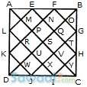
RV College of Engineering
Unit 1- Logical Reasoning and Algorithmic Problem Solving
Go, change the world
Skill development – Examples related to Arithmetical Reasoning and Analytical Reasoning
Example 1:
Find the number of triangles in the given figure.
36

Slide 11

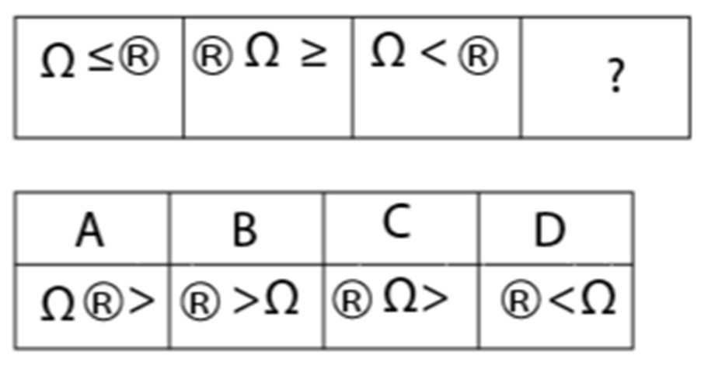
RV College of Engineering
Unit 1- Logical Reasoning and Algorithmic Problem Solving
Go, change the world
Skill development – Examples related to Arithmetical Reasoning and Analytical Reasoning
Example 2:
What resembles the water image of ADVANCE
Example 3:
What will come in the place of question mark (?) in the below series

Slide 12
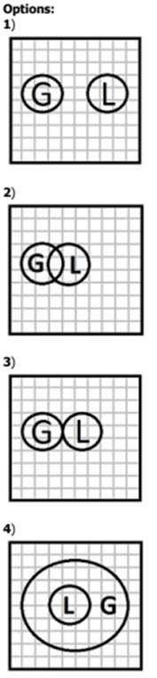
RV College of Engineering
Unit 1- Logical Reasoning and Algorithmic Problem Solving
Go, change the world
Skill development – Examples related to Arithmetical Reasoning and Analytical Reasoning
Example 4:
In a village some of the goldsmiths are literates. Which diagram shows literate goldsmiths?

Slide 13

RV College of Engineering
Unit 1- Logical Reasoning and Algorithmic Problem Solving
Go, change the world
Skill development – Examples related to Arithmetical Reasoning and Analytical Reasoning
Example 5:
What does this symbol mean '&'?
Example 6:
How many lines of symmetry does a Pentagon have?
A regular Pentagon have 5 sides and 5 lines of symmetry.
The number of lines of symmetry in a regular polygon is equal to the number of sides.

Slide 14
RV College of Engineering
Unit 1- Logical Reasoning and Algorithmic Problem Solving
Go, change the world
Skill development – Examples related to Arithmetical Reasoning and Analytical Reasoning
Example 7:
Pankaj is taller than Vinod, who is shorter than Pramod. Usha is taller then priyanka but shorter than Vinod. Pramod is shorter than Pankaj. Who is the tallest?
Pankaj

